Slide 1
Examples of Applications of
Higher Order Theorem Proving

Slide 2
Content
Applications of Higher Order Theorem Proving :
  Verification of distributed algorithms
  Verification of cryptographic protocols
Notes:
  In both the approach is by embedding suitable logics in HOL
  We can handle infinite state space ☺
  Expect lots of manual proofs.
  But we can still program heuristics to eliminate trivialities and frequently occurring subgoals.
Challenges:
  How to represent in HOL ?
  How to automate ?

Slide 3
Embedding a Logic for Distributed Systems

Slide 4
UNITY
Based on UNITY, proposed by Chandy and Misra, 1988, in Parallel Program Design: a Foundation.
Later, 2001, becomes Seuss, with a bit OO-flavour in: A Dicipline of Multiprogramming: Programming Theory for Distributed Applications
Unlike LTL, UNITY defines its logic Axiomatically:
  more abstract (so easier to understand).
  more suitable for deductive style of proving
  with HOL support good for verifying (high level) algorithms
  not very good to handle models at e.g. Promela level.

Slide 5
UNITY Program & Execution
A program P is (simplified) a pair (Init,A)
Init : a predicate specifying allowed initial states
A : a set of concurrent (atomic and guarded) actions
Execution model :
  Each action α is executed atomically. Only when its guard is enabled (true), α can be selected for execution.
  A run of P is infinite. At each step an enabled action is non-deterministically selected for execution. The run has to be weakly fair: when an action is continuously enabled, it will eventually be selected. When no action is enabled, the system stutters (does a skip).
However the logic is axiomatic. It will not actually construct the runs. → next slides.

Slide 6
Parallel composition
Can be expressed straight forwardly :
(Init₁, A₁) [] (Init₂, A₂) = (Init₁ /\ Init₁ , A₁ ∪ A₂ )

Slide 7


Temporal properties
Safety is expressed by this operator:
Whenever p holds the program will either stay in p, or go over to q.
Embedding this in HOL is straight forward:
NOT, AND, OR → lifting ~, /\, \/ to function space, e.g.
(Init,A) |- p unless q = ∀α∈A. { p /\ ¬q } α { p \/ q }
Recall that we have chosen to represent predicates with functions State→bool. So e.g. boolean /\ can’t be used to conjuct them.
Define `unless (Init,A) p q
=
∀α. α∈A ⇒ HOARE (p AND NOT q) α (p OR q)`
Define `p AND q = ( λs. p s /\ q s )`
Notes:
Corresponds to [](p → p W q) in LTL.
Subtle difference with LTL
P = Init x>0, action: x++
In LTL holds [](x<0 weakuntil x>0), well because P will never reach the state x<0.
This property does not hold in Unity however; so Unity is incomplete wrt LTL. This is later on patched
by the Substitution axiom.
Using Subst Ax. it would be like this:
(1) Inv of P: x>=0 // well, not the strongest one, but it is an invariant
(2) false unless x>0 in P // follows from def. of unless
(3) Inv of P: (x<0 = false) // equivalent as (1)
(4) x<0 unless x>0 in P // rewrite (2) with SYM of (3)

Slide 8

Progress-1
A predicate p is transient in P=(Init,A) if there is an action in A that can make it false.
Now define:
The weak fairness assumption now forces P to progress from p to q. (implying [](p → <>q))
Also straight forward to embed in HOL, e.g. :
(I,A) |- transient p = ∃α∈A. { p } α { ¬p }
(I,A) |- p ensures q = (I,A) |- p unless q
and (I,A) |- transient (p /\ ¬q)
Define `transient (Init,A) = ∃α. α∈A /\ HOARE p α (NOT p)`
Notes:
Again here you have that incompleteness issue again, which has to be patched by Subst Ax.

Slide 9
Progress-Gen
“ensures” only captures progress driven by a single action. More general progress is expressed by |→ (leads-to).
It is defined as the smallest relation satisfying:
p ensures q
--------------------- // ensures lifting
p |→ q
p |→ q , q |→ r
------------------------------ // transitivity
p |→ r
p₁ |→ q , p₂ |→ q
--------------------------------- // disjunctivity
p₁ \/ p₂ |→ q
Acting as the basic rules to infer general progress
But … how to
define this
in HOL?

Slide 10
Embedding “leads-to” in HOL
Define Elift P Rel = ∀p q. ensures P p q ⇒ Rel p q
Define Trans Rel = ∀p q r. Rel p q /\ Rel q r ⇒ Rel p r
Define Disj Rel = …
Define LeadstoLike P Rel
=
Elift P Rel /\ Trans Rel /\ Disj Rel
Define leadsto P p q
=
∀Rel. LeadstoLike P Rel ⇒ Rel p q
Specifying all relations which are ens-lifting, transitive, and disjunctive.
A bit indirectly this says that leadsto is the smallest Leadsto-like relation.
True, this definition does not directly give you Elift, Trans, and Disj for leadsto. But you can prove that leadsto is also LeadstoLike, hence you can recover Elift, Trans, and Disj!
Notes:
For example, to prove that leadsto also includes ensures:
We have to prove Elift P (leadsto P). So, for every p,q we have to prove:
ensures P p q ==> leadsto P p q
=
ensures P p q ==> (Forall Rel. LeadstoLike P Rel ==> Rel p q)
However, if Rel is leadsto-like, then it also includes ensures (so, Elift P Rel); therefore Rel p q must hold.
Prove of PSP
Sufficient to prove that Rel p q = leadsto (p/\a) ((q/\a)\/b) is leadstolike
ensures p q /\ unless a b ➔ ensures p/\a ((q/\a) \/ b)
leadsto (p/\a) ((q/\a)\/b) , leadsto (q/\a) ((r/\a) \/ b) implies leadsto (p/\a) ((r/\a)\/b)
leadsto (p1/\a) ((q/\a)\/b), leadsto (p2/\a) ((q/\a)\/b) imply leadsto ((p1\/p2)/\a) ((q/\a)\/b)

Slide 11



Some other (derived) laws
|→ itself is relf, trans, and disj.
Progress – Safety
Bounded progress
p |→ q , a unless b
--------------------------------------
p /\ a |→ (q /\ a) \/ b
p /\ m=C |→ (p /\ m<C) \/ q
----------------------------------------------------
p |→ q
0 < m holds innitially
0 < m unless false
Notes:
Proof of PSP.
Define Prop p q = (a unl b) ➔ (p/\a lto q/\a \/ b)
We will prove that !p q. P lto q ➔ Prop p q. We use the fact that lto is the smallest relation satisfying lift, trans, and dijs. So if we have prove that Prop satisfies the same, then we are done.
(i) P ens q implies Prop p q ; easy.
(ii) Prove that Prop p q /\ Prop q r implies Prop p r ; easy
(iii) Prove that Prop p1 q /\ Prop p2 q implies Prop (p1\/P2) r ; easy
--------------------------
Proof of WF.
Using WF induction principle: If for all y: (!x. X<y ➔ P x) ➔ P y; then P y holds universally for all y.
Take P x = p /\ m=x lto q.
Assume that for all x such that x<y we have p /\ m=x lto q
Premise of the rule assumed p /\ m=y lto (p /\ m<y) \/ q
From (1) it follows that p /\ m<y lto q
Combining 2 and 3, we have p /\ m=y lto q
So, we have P y
By WF induction then P y holds on all y
Applying disjunction on all those P y’s implies p lto q

Slide 12
Example
Self-stabilizing leader election in a ring.
Problem-1: Leader Election (LE).
for time to time a ring of processes need to appoint a ‘leader’. A centralized decision is undesired.
Problem-2: Self-Stabilizing (SS).
It can start from any state.
A solution: (see left) → relies on the non-determinism of concurrency.
copy
5
0
copy
copy
2
min
10

Slide 13



The selection is non-deterministic
copy
5
copy
10
0
0
10
copy
copy
copy
copy
2
0
10
min
min
10
0
10
(0 mod 4) is selected as the leader.
But we can also end up with (10 mod 4) as the leader.
True, the nodes are not identical. If all nodes are identical (they have identical ID and do the same thing) LE is unfortunately impossible.

Slide 14
Encoding it in HOL
node i = x[i-1] ≠ x[i] → x[i] := x[i-1]
Guarded assignment. Model in HOL:
Define GUARDED g a = IF g a SKIP
“enabledness” is not explicitly modeled → a disabled action cannot be selected; so its effect is skip. So, we modeled as above. This is ok because we don’t have an explicit concept of executions anyway.
node0 N = if x[N-1] < x[0] then x[0] := x[N-1]
Define ring N = { node0 N } ∪ { node i | 0<i /\ i<N }

Slide 15


Specification
copy
copy
copy
min
Define `done k = (\x. (∀i. 0≤i<k ⇒ (x i = x 0))`
leadsto (ring N) (\x. T) (done N)
unless (ring N) (done N) (\x. F)

Slide 16
Verification
In SPIN you would verify this for N = 1,2,3 and then argue that other N is just analogous to N=3.
In HOL you can prove the correctness for all N.
In the proof you will need to come up with a “progress metric” m. Then show this :
m=C |→ m < C \/ done N
where “<“ is some well-founded relation over finite domain D. Well-founded means that every subset of D has a minimum element wrt <.
In HOL you can also prove general theories about e.g. self-stabilization, classes of distributed algorithms.

Slide 17
Verification of Cryptographic Protocols with HOL

Slide 18
Reference
Proving Properties of Security Protocols by Induction, tech. rep. by Paulson.

Slide 19
Cryptographic Protocol
Having a strong encryption method like RSA is not sufficient in order to secure our electronic “transactions”.
We furthermore need to implement a certain protocol; but this protocol is often very error prone.
Most cryptographic protocols are simple, but surprisingly very difficult to verify, due to complex ways a “spy” may interfere.
Additional aspects may further add complexity:
  people may accidentally lose old keys
  authenticity
  sometimes non-tracability is required

Slide 20
Notation
A,B,C : agents, parties involved in the protocols.
Agents can send messages to each other.
{| M |} : a message M
{| M, N |} : a message containing the tuple M , N
{| M |}_{K} : message M, encrypted with the key K

Slide 21
Notation
K : key
K_{A} : A’s private keys
pubK_{A} : A’s public keys
If K is a shared key, then an agent can decrypt {|M|}_{K} only if he also has K
If K is a public key (in private-public key scheme), then {|M|}_{K} can only be decrypted with the corresponding private key.

Slide 22
A simple protocol P₀
A and B want to chat securely. They first exchange a session key. This is a shared key that will be used to encrypt the rest of the communication.
A → B : {| pubK_{A} |} // here is my pub-key
B → A : {| k |}_{pubKA} // ok , here is a session key
From this point on A and B exchanges messages encrypted with the shared key k.

Slide 23
Man-in-the-Middle Attack
A → B : {| pubK_{A} |}
// intercepted by Spy !
Spy → B : {| pubK_{Spy} |}
B → Spy : {| k |}_{pubKspy}
Spy → A : {| k |}_{pubKA}
A and B now communicate using the session key k, unaware that Spy also knows k.

Slide 24



Now A and B try to use a KeyServer
There is now a trusted server S : it also knows the private keys of A and B. When A want to communicate with B, it first requests a session key to S. This key has to be securely distributed to A and B.
A possible way to do it:
A → S : {| A, B |}
S → A : {| B, k, {| k, A |}_{KB} |} _{KA}
A → B : {| k, A |}_{KB}
A prompts S that it wants to start a session with B.
S generates a seesion key k, send it back encrypted to A. It also prepare a copy of the key for B, encrypted privately for B.
A pass on the encrypted copy of k to B
However people/application may accidentally lose old session keys. If Spy somehow gets an older packg in step 2, and the corresponding session key k, it can resend that old pckg to A, when A requests S for a new session key. But now k is compromised. Called replay attack.

Slide 25
Needham-Schroeder Protocol
Idea: use fresh numbers, so-called nonces, to identify each session. So now you can’t replay.
Protocol:
A → S : {| A, B, η_{A} |} , η is a nonce
S → A : {| η_{A}, B, k, {| k, A |}_{KB} |} _{KA}
A → B : {| k, A |}_{KB}
B → A : {| η_{B} |}_{k}
A → B : {| η_{B} - 1 |}_{k}
Unfortunately... this is not really right yet, This part is still vulnerable to replay attack.

Slide 26
Some formal approaches
Model checking. Model the protocol (and Spy) as automatons, then check that every state is safe.
+ Find attacks quickly.
- State explosion (forcing simplifying assumptions)
Belief logic, e.g. Burrows-Abadi-Needham (BAN logic).
+ Short, abstract proofs.
- Some variants are complicated & ill-motivated
Inductive approach → Paulson. Mechanized in Isabelle/HOL.

Slide 27
Inductive Approach
Features
  Seems to be feasible
  Based on a clear logical framework
Statistics:
  200 theorems about 10 protocol variants
  (3 × Otway-Rees, 2 × Yahalom, Needham-Schroeder, . . .)
  110 laws proved concerning messages
  2–9 minutes CPU time per protocol
  few hours or days human time per protocol
  over 1200 proof commands in all

Slide 28

Representing Messages
data Agent = Server | Friend int | Spy
Use A,B,C … to denote agents.
data Msg = Agent A
| Nonce N
| Key K
| {| X , Y |}
| Hash X
| Crypt K X // {| X |}_{K}
Can be easily
translated to HOL
Use X,Y, … to denote message

Slide 29

Representing Events
Protocol steps are represented by events:
Example:
A → B : {| k, A |}_{KB}
is represented by
Say A B (Crypt K_{B} {| k , A |} )
data Event = Say Agent Agent Msg

Slide 30
Model
C
B
spy
A
H
We maintain a history evs, which is a set of all communication events so far.
Agents are assumed to monitor evs. When an agent B sees an event “Say A B X” in evs it knows that there is a message X from him and can act accordingly.
( However B does not actually know who sends it (it could be Spy). So B can only infer “Say ? B X” from evs. )
Spy also has access to evs.

Slide 31


Representing Protocol Steps
Every step σ of the protocol is a function of type:
such that evs₂ ∈ σ evs₁ means that evs₂ is a possible history after executing σ on the history evs₁.
(So, σ can be non-deterministic)
Add a SPY-step (same type as above).
A protocol can be defined by a transition function
such that evs₂ ∈ Protocol evs₁ iff this is allowed by one of the protocol steps or SPY-step.
σ : Event set → (Event set ) set
Protocol : Event set → (Event set) set

Slide 32

Representing the Protocol Steps
A → S : {| A, B |}
S → A : {| B, k, {| k, A |}_{KB} |} _{KA}
A → B : {| k, A |}_{KB}
Step-1 can be modeled by a function σ₁
σ₁ H = H ∪ { Say A S {| A, B |} }

Slide 33

Representing the Protocol Steps
A → S : {| A, B |}
S → A : {| B, k, {| k, A |}_{KB} |} _{KA}
A → B : {| k, A |}_{KB}
σ₂ H =
if Say X S {| Y, Z |} ∈ evs, for some X,Y, Z
then
H ∪ { Say S Y (Crypt K_{Y} {| Z, k, Crypt K_{Z} {| k, X |} |} ) }
else H

Slide 34
Some concepts
Let H be a set of messages.
parts H : all parts of the messages in H, applying
decryption when necessary.
What God can infer from H ☺
analz H : all parts of messages in H, applying
decryption with keys exposed in H.
What Spy can infer from H.
synth H : all spoof messages Spy can construct
from H. In particular, synth (analz H) is interesting.

Slide 35
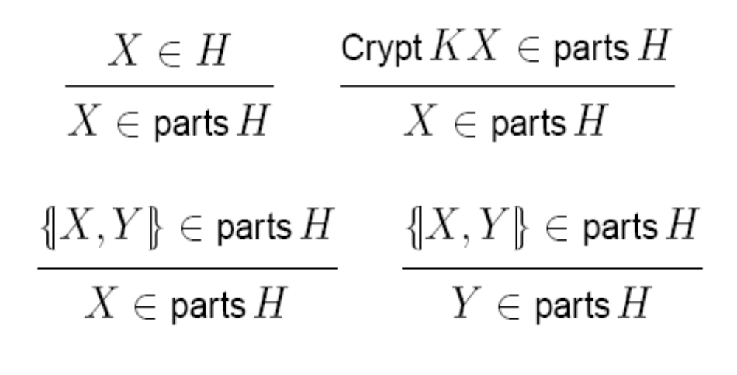
Inductive Def. of parts
Decryption
More precisely, parts is the smallest predicate satisfying the above rules. We can define this in HOL indirectly as we did with the “leadsto” relation in UNITY.

Slide 36
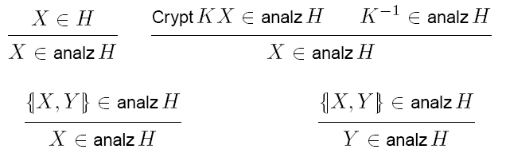
Analz
If Spy can infer the key, then it can decrypt.

Slide 37
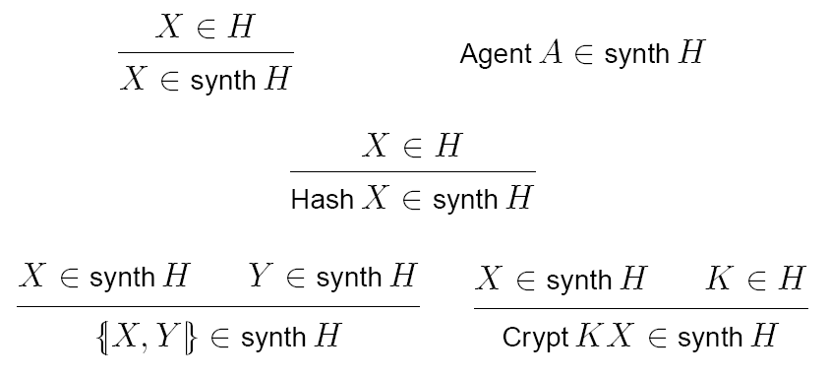
Synth
Agents’ names are assumed to be public.

Slide 38


Spy’s steps
Say Spy B X
Spy can extend H with
where B is any agent (other than Spy) and X is any spoof message drawn from:
where
  Ini is Spy’s initial knowledge, e.g. the “names/id” of some agents.
synth ( analz ( H ∪ Ini ))

Slide 39

Oops rule
You may want to model schemes where some agents are sometimes careless and lose their past session keys.
This can be modeled by the following “oops” rule.
If a past H contains an event where Server distributes a session key k to A, marked with some nonces e.g. η_{A} and η_{B}, and that this nonces belong to past sessions, then add this to current H :
Say A Spy {| k , η_{A} , η_{B} |}

Slide 40


Protocol Run
The “run” can be defined inductively :
run 0 = possible initial histories, e.g. just { [] }
run n = the set of possible histories after n-steps
of the protocol (+spy).
Security property safe can be defined over run, in the form:
Can be proven with induction.
run : num → (Events set) set
∀n. ∀H. H ∈ run n ⇒ safe H

Slide 41

Example of specification
First extend the protocol with
B→A : {| o |}_{k}
as the last step, to model the sending of a data message encrypted using the exchanged session key.
In KeyServer, also allow the oops rule.
Spec: o ∉ H

